Slide 1
Pulsations in the Magnetosphere
Jacob Schneider
David Sibeck

Slide 2
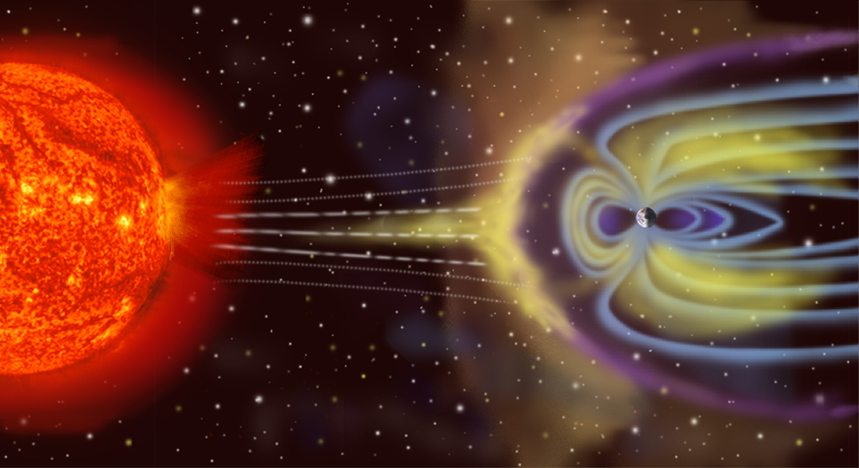
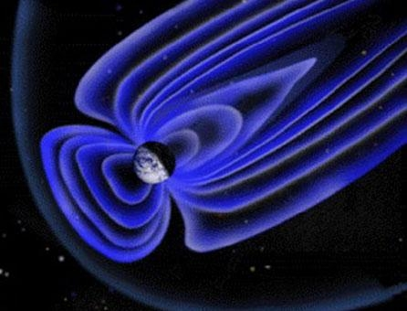
Magnetosphere
Solar wind constantly collides with Earth’s magnetic field creating a cavity
Extends about 15-25 Earth radii in different directions
Protects life on earth from harmful radiation

Slide 3

Earth’s Magnetic Field Lines

Slide 4
Magnetohydrodynamics(MHD)
A vast sea of electrically charged plasma flows through the magnetosphere
Conventional fluid dynamics fails because of the magnetic field
A combination of the Navier-Stokes equation with Maxwell’s equations
Magnetic field induce currents which create pressures on the plasma fluid. These pressures in turn modify the magnetic fields creating a complicated coupled system.

Slide 5
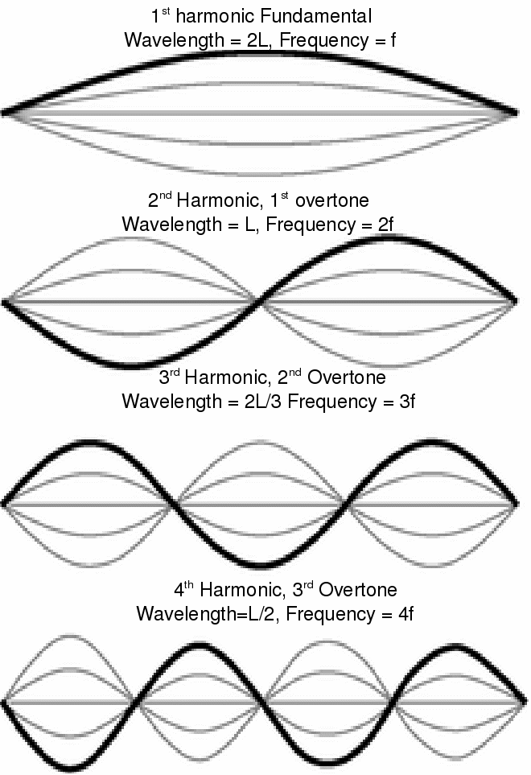
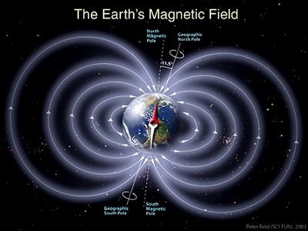
Pulsations
Near the Earth the field lines can be approximated as a simple magnetic dipole
These lines can be stretched and compressed and they oscillate
The lines act similar to guitar strings: 2nd harmonic with node at equator

Slide 6
Compressional Pc5 Pulsations
Pc5 pulsations are ultra low frequency (ULF) oscillations of the magnetic field lines with periods ranging from around 2-20 minutes.
They usually occur at a distance of around 8 Earth radii in the magnetosphere.
No one knows the exact cause or origin and the phenomenon has not been studied in depth.

Slide 7
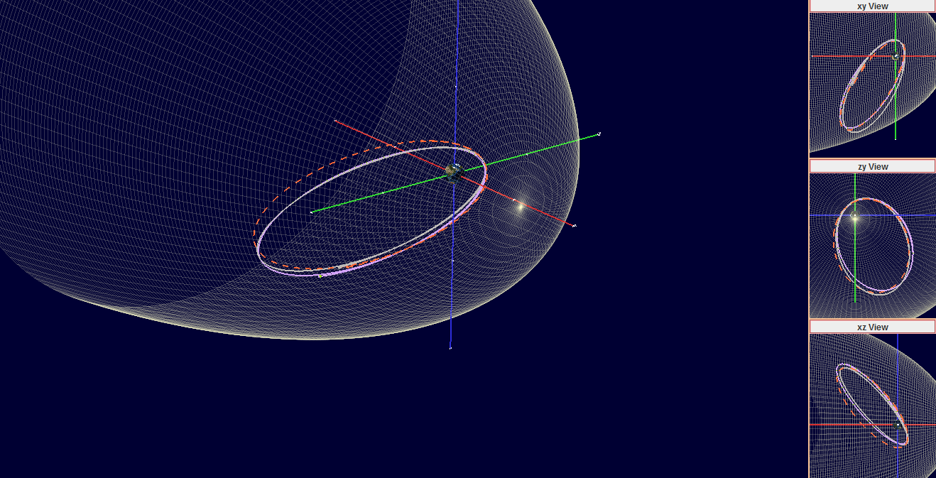
Cluster Spacecraft
4 spacecraft in a tetrahedron formation with a polar orbit with a period of around a day
The orbit processes around the earth with a period of around a year
I created an algorithm with Fourier analysis to find Pc5 pulsation events

Slide 8
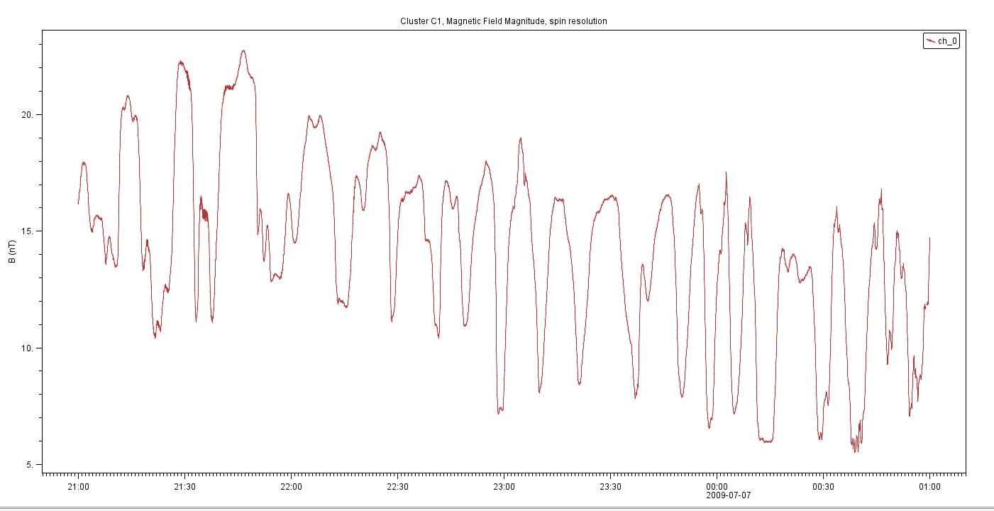
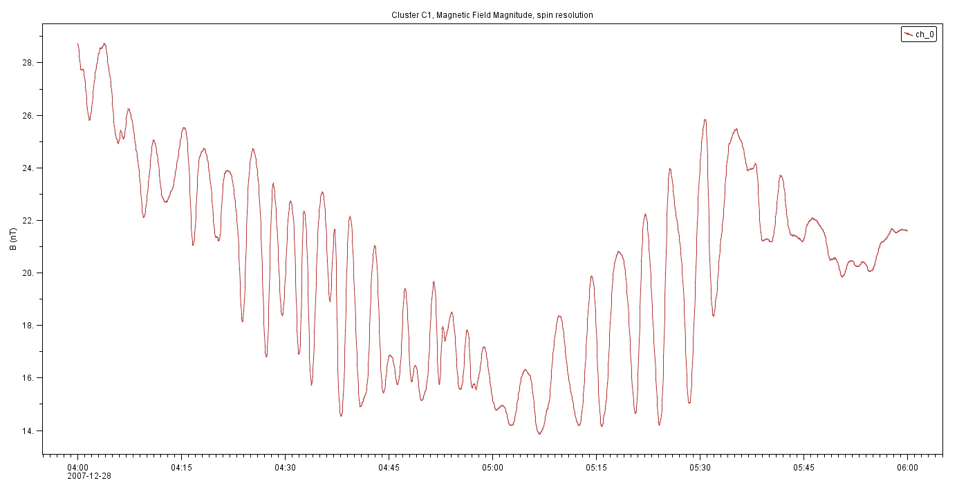

Dusk vs. Dawn Oscillations
Over 90% of observed oscillations occurred within 20 degrees from the dawn and dusk meridians and within 30 degrees from the equatorial plane
Dawn Side:
2009-07-07
B(nT)
21:00 UT
01:00 UT
2007-12-28
Dusk Side:
B(nT)
04:00 UT
Equator
06:00 UT

Slide 9
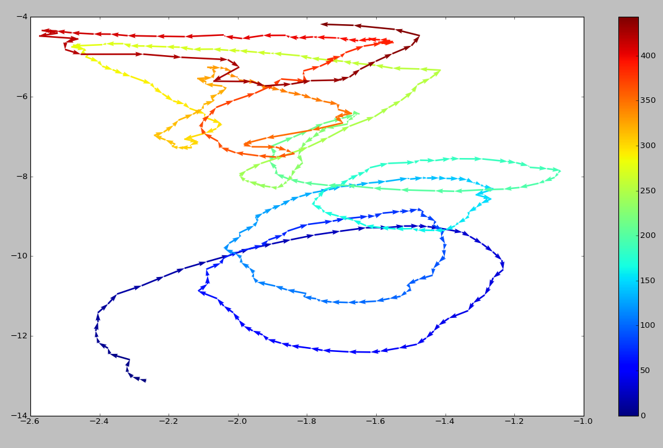
Polarization Reversal
Time
B_{y}(nPa)
B_{x}(nPa)

Slide 10
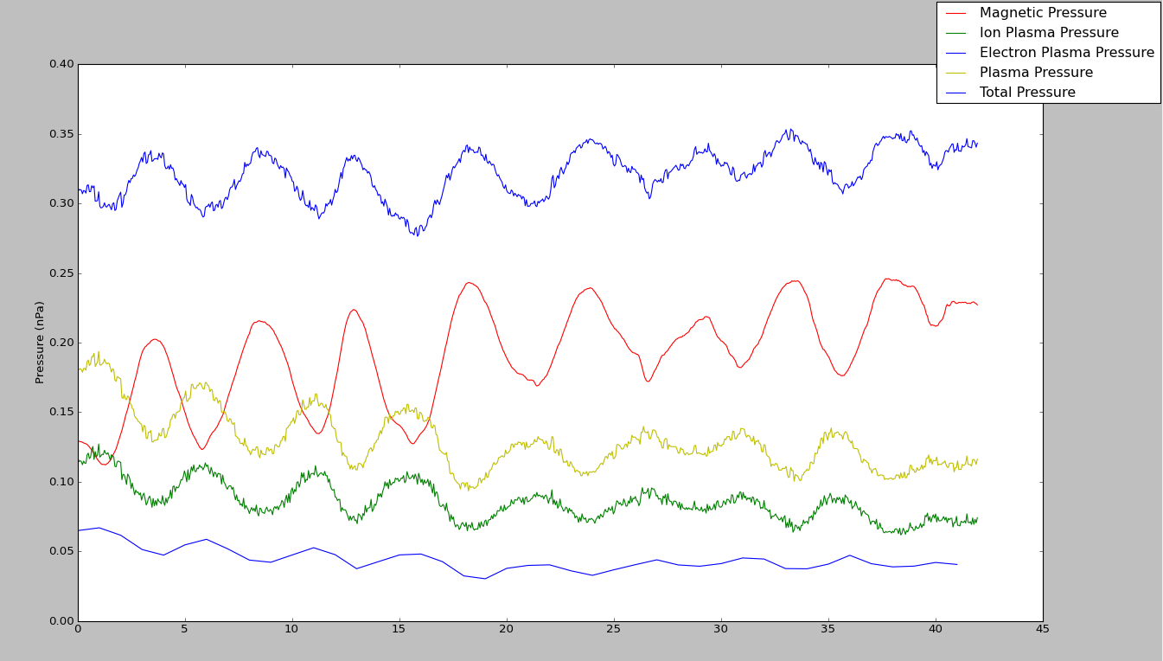
Pressure Balance Test
Pressure is not perfectly constant
Due to missing energy ranges in plasma measurements

Slide 11
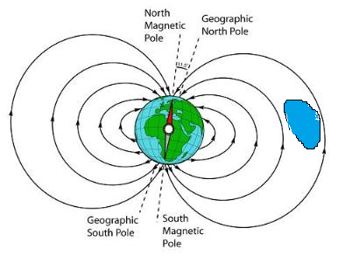
Ballooning Mirror Mode Instability
Leading theory explaining the
origin of compressional Pc5 pulsations
You can think of it as a traveling
blob of plasma “balloons” and
expands greatly and then pops
This pushes the magnetic field out of the way and when the blob pops the tension in the field is relieved and the field oscillates
This ballooning occurs when a certain set of instability conditions are met. The parameters for this instability:
High Beta = Plasma Pressure / Magnetic Pressure
High Temperature Anisotropy

Slide 12
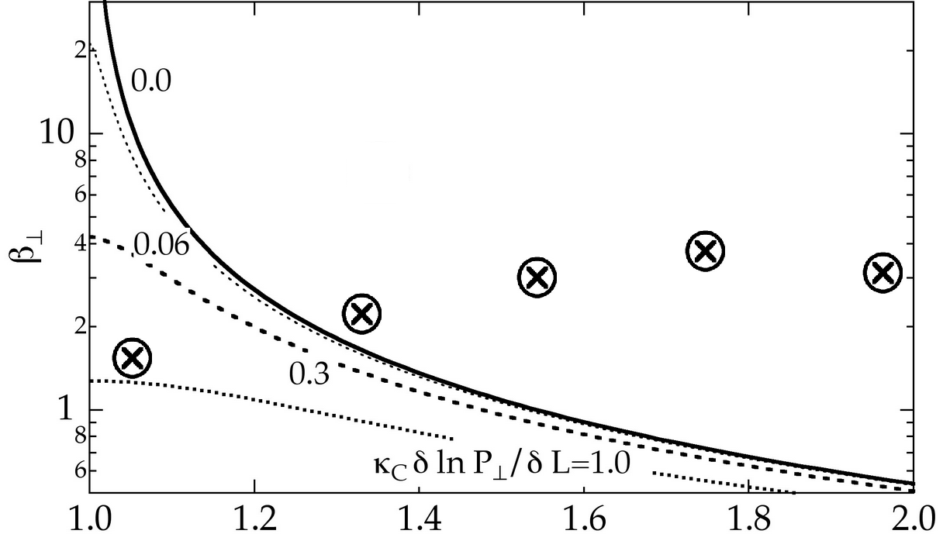
Instability Criterion Test
Unstable
Stable
Temperature Anisotropy

Slide 13
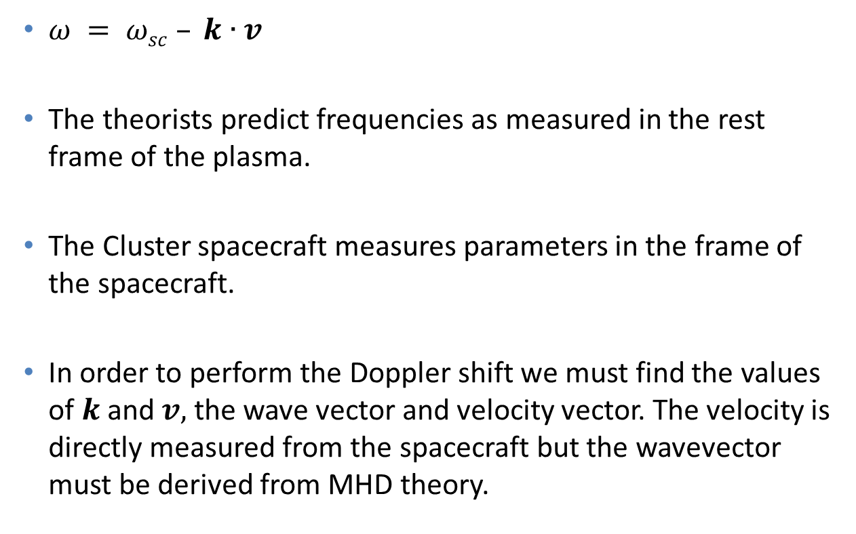
Doppler Shift
$ω = ωsc – k∙v$
The theorists predict frequencies as measured in the rest frame of the plasma.
The Cluster spacecraft measures parameters in the frame of the spacecraft.
In order to perform the Doppler shift we must find the values of $k$ and $v,$ the wave vector and velocity vector. The velocity is directly measured from the spacecraft but the wavevector must be derived from MHD theory.

Slide 14
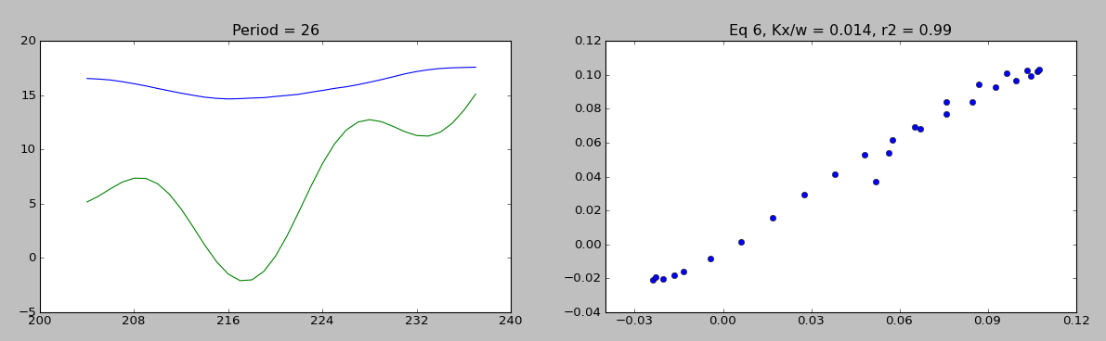

Fit to Linear MHD
Using small perturbation theory on MHD we can derive linear equations describing the behavior of these waves
$\frac{δB_{||}}{B_{0}}=\frac{k_{x}}{ω}δv_{x}+\frac{k_{y}}{ω}δv_{y}$
B(nT)
Time

Slide 15
Conclusion
Findings
78 events found over 3 years
80 percent satisfy instability criterion
Dusk/Dawn dichotomy
Polarization flips and oscillation minimums occur at equator
2nd harmonic waves
Pressure balance
Future:
Timing studies
Impact on radiation belt particles(rbsp aug 23 launch)

